Slide 1


Voice Care
A voice for Health
Antonio Boccarossa M63001643
Francesco Brunello M63001655

Slide 2

CONTENTS
01
What’s the problem?
02
Solution Proposed
03
System Architecture
04
Web Page
05
Analytics
06
Used Technologies

Slide 3



What’s the problem?
In healthcare sector, especially in emergency departments, medical personnel are often forced to manually transcribe clinical notes under conditions of stress and urgency.
This process is clearly:
Slow and time-consuming
Not optimized for integration with modern healthcare information systems

Slide 4



Solution Proposed
Voice2Care – A voice for health
An integrated system that automates the clinical documentation process starting from vocal recordings
Thanks to speech recognition technologies, Large Language Models, and an interactive dashboard, the platform enables:
The automatic transcription of voice notes
The extraction and structuring of relevant clinical information in order to generate a structured report in PDF format
Fast and scalable storage through a NoSQL document-based database

Slide 5
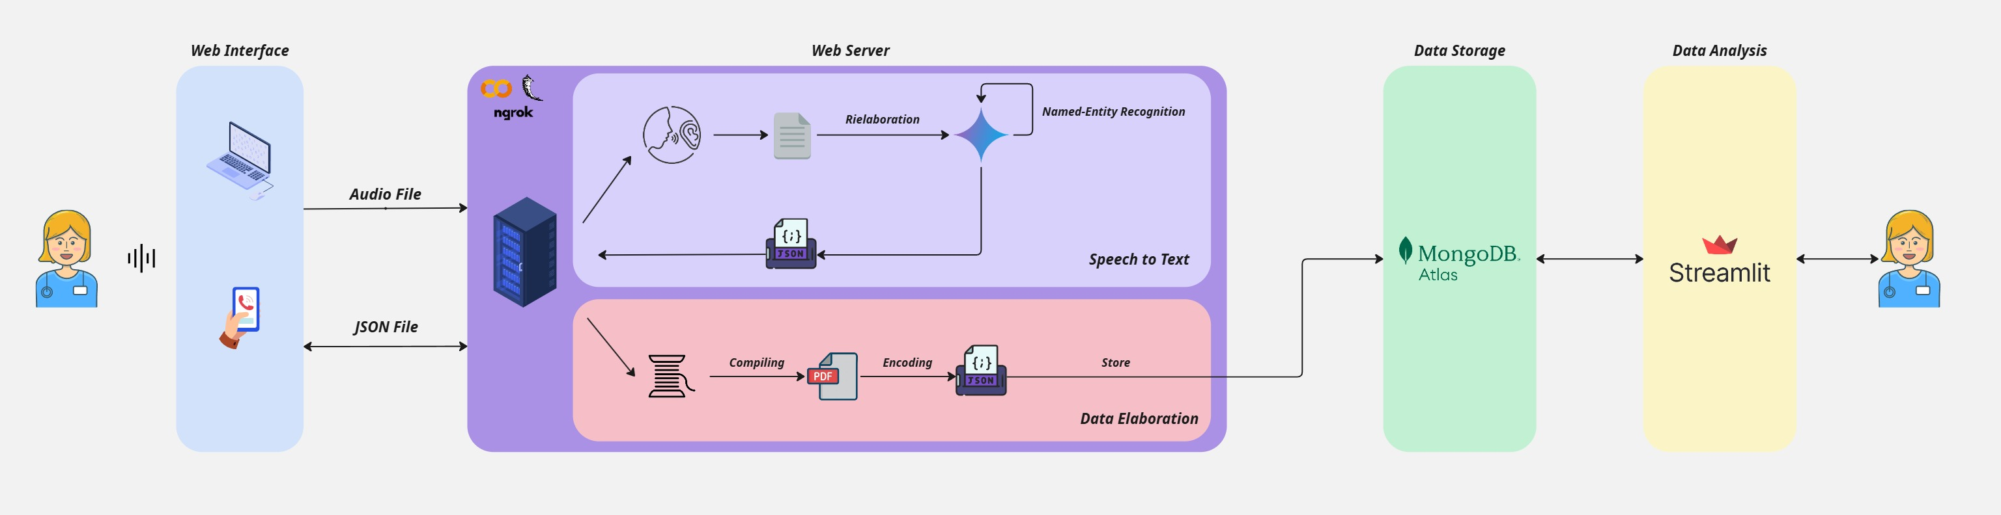
System Architecture

Slide 6
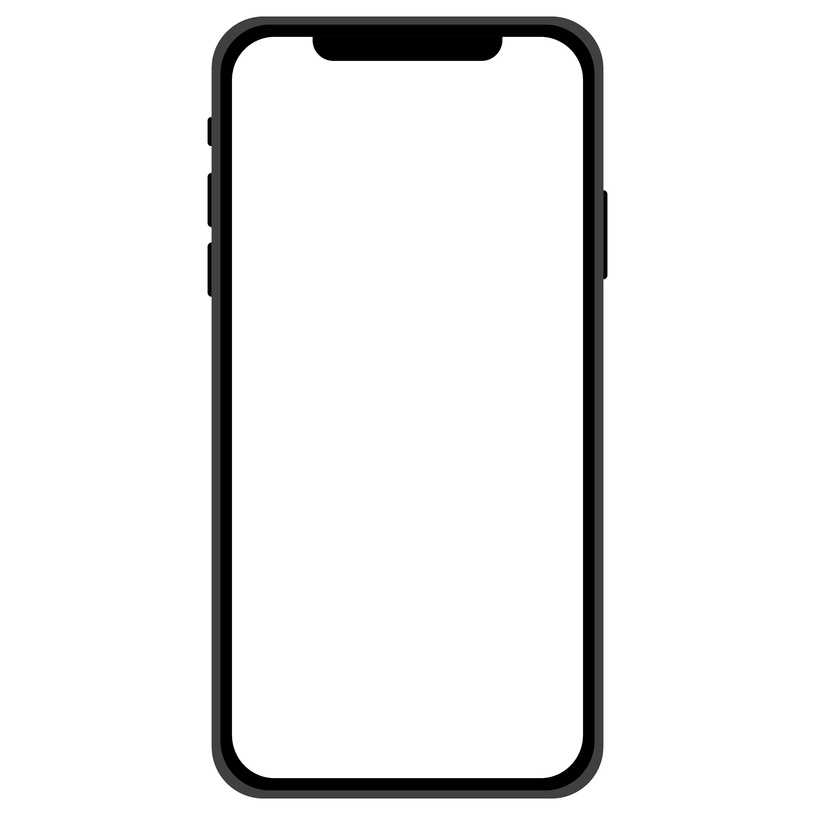



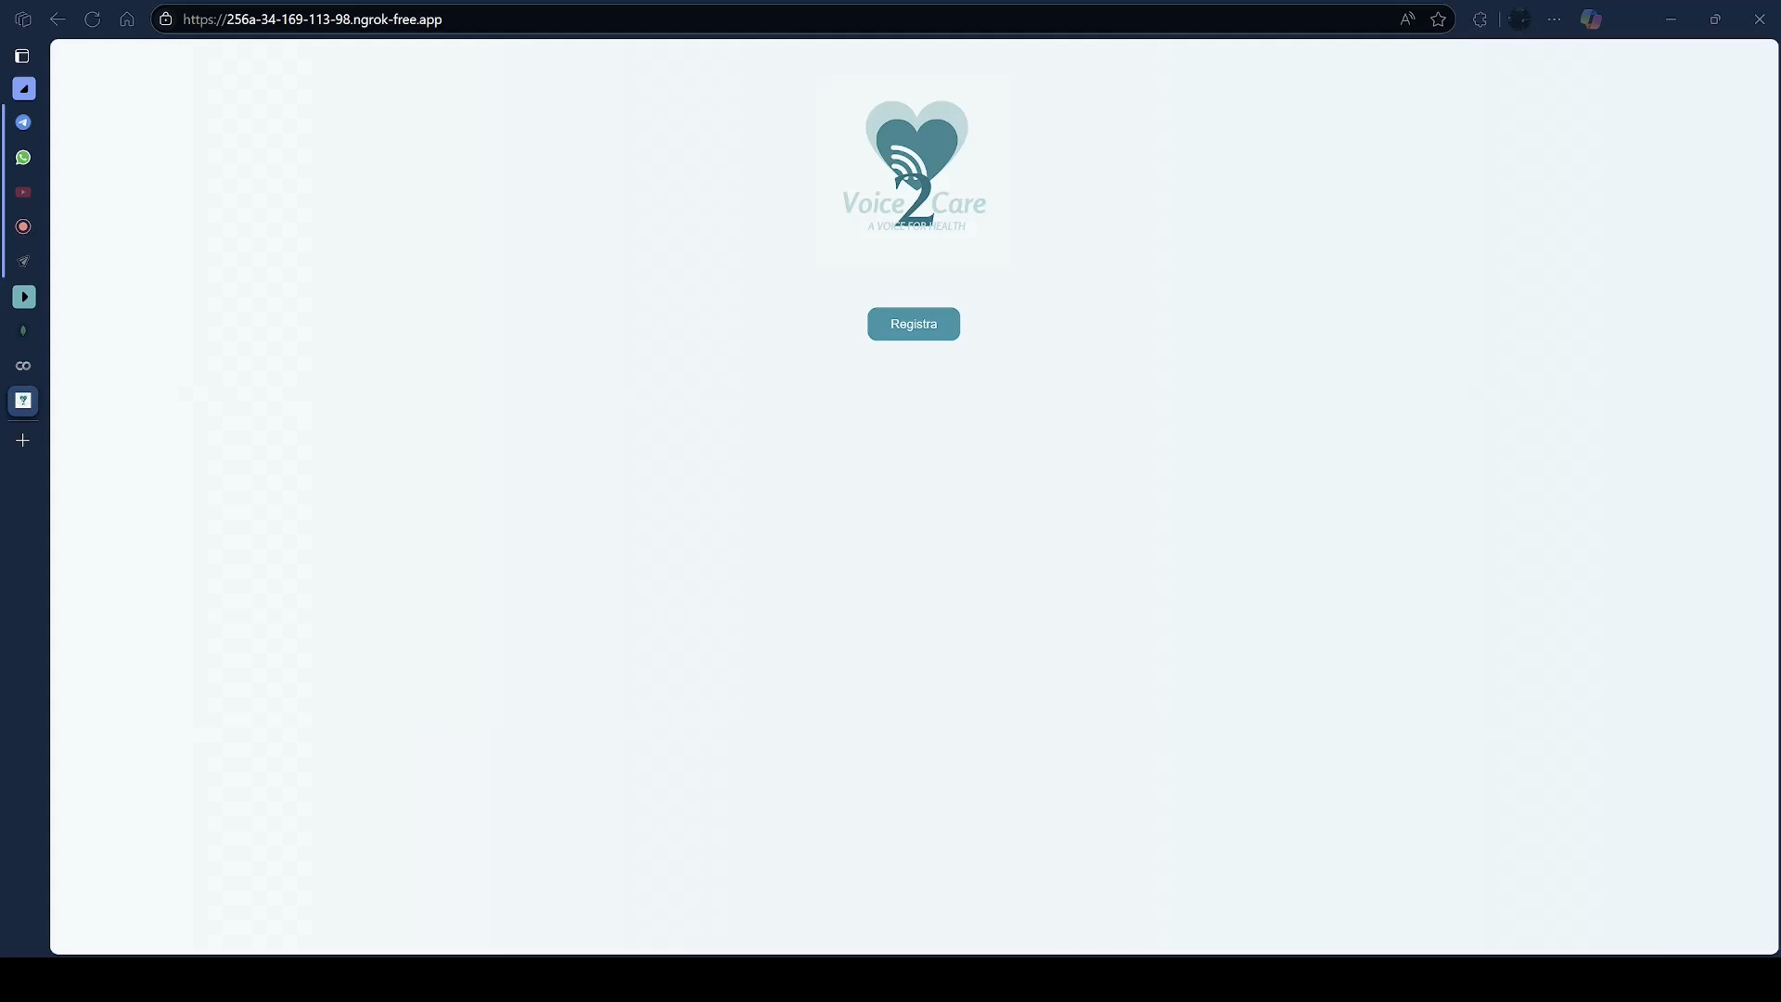
Web Page

Slide 7
Analytics
Analytic 1️⃣: Retrieve all documents for a specific year and month, with a map of residences
Analytic 2️⃣: Report the number of patients with one or more specific injuries for each year, using a bar chart
Analytic 3️⃣: Find the average service time per month for each year, specifying the city
Analytic 4️⃣: Report the number of measures used in the areas of breathing, circulation, immobilization, or others based on the selected year
Analytic 5️⃣: Calculate the average heart rate value for the specified sex based on the year and month (if specified)

Slide 8







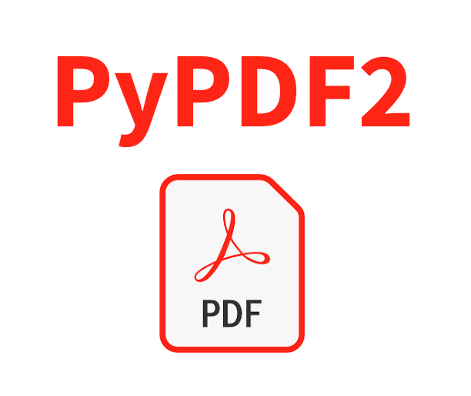

Technologies Used

Slide 9
THANK YOU
Credits to SlideChef-Download Free PowerPoint templates and Google Slides themes for the template

